Slide 1
School of Geography and Earth Sciences McMaster University
Applied Spatial Statistics
Area Data
III & IV

Slide 2
This session:
Area Data III & IV
  Exploration of First Order Effects
  Exploration of Second Order Effects
    Spatial correlation
    Local spatial association
  Example

Slide 3
Exploration:
Spatial Moving Averages
Variations on the mean value of a variable
Weighted average of the values in neighboring areas

Slide 4
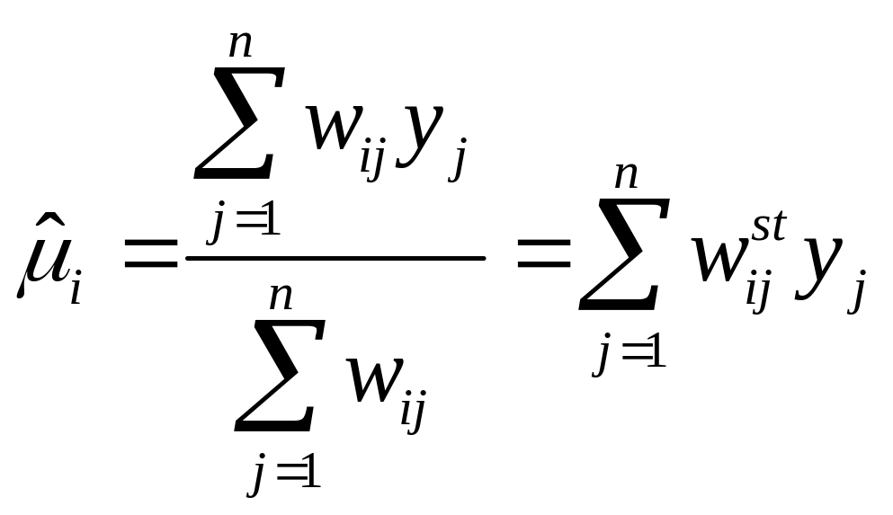
Exploration:
Spatial Moving Averages

Slide 5
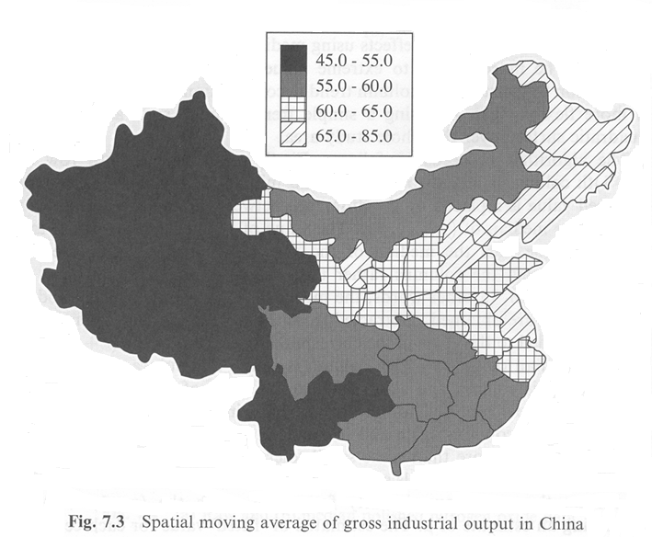
Exploration:
Spatial Moving Averages

Slide 6
Exploration: Kernel Estimation
Convert areas to points (i.e. use centroids)

Slide 7
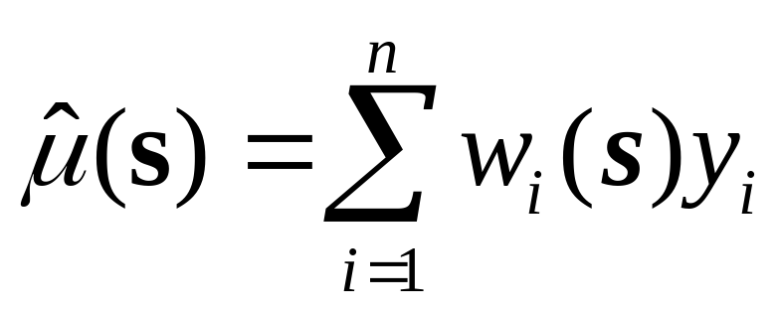
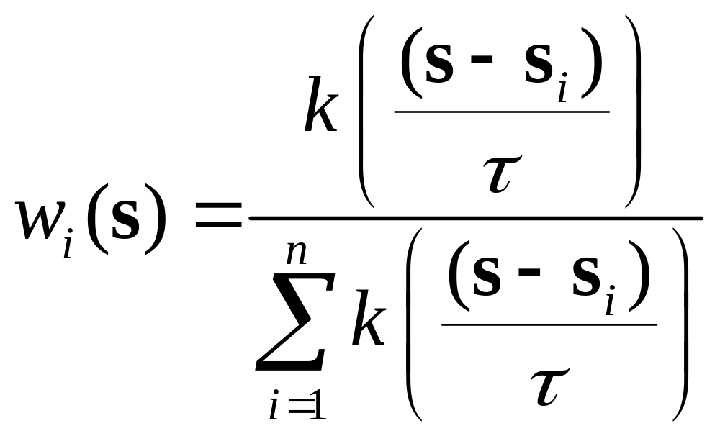
Exploration: Kernel Estimation

Slide 8
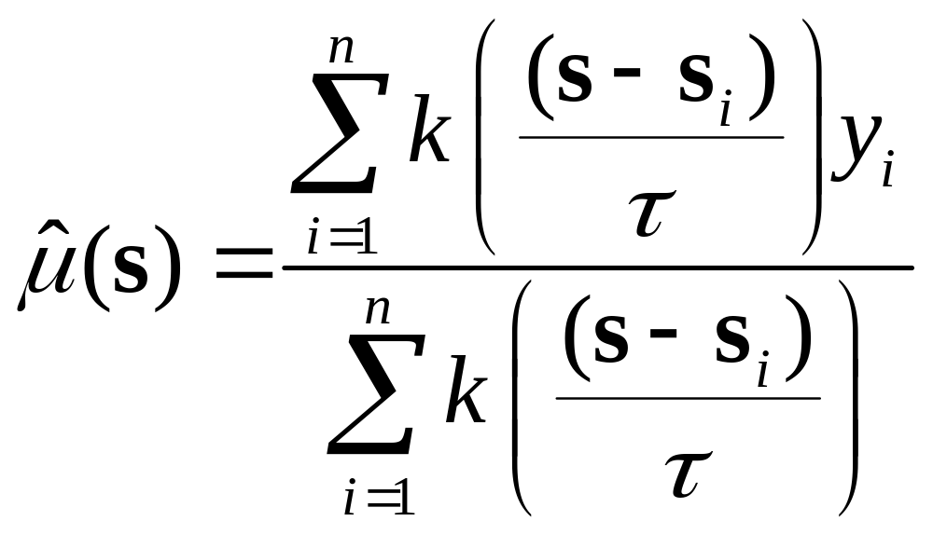
Exploration: Kernel Estimation

Slide 9
Second Order Effects
Spatial dependency/association/correlation

Slide 10
Spatial dependency
Do attributes in “neighboring” zones show spatial dependency? i.e. Do they co-vary?

Slide 11
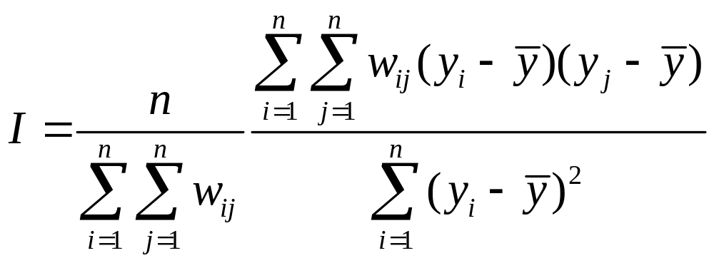
Spatial Correlation
Moran’s I

Slide 12
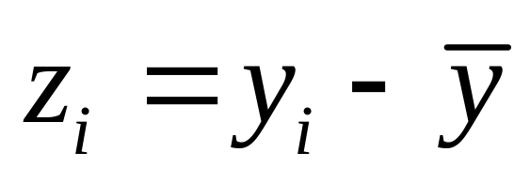
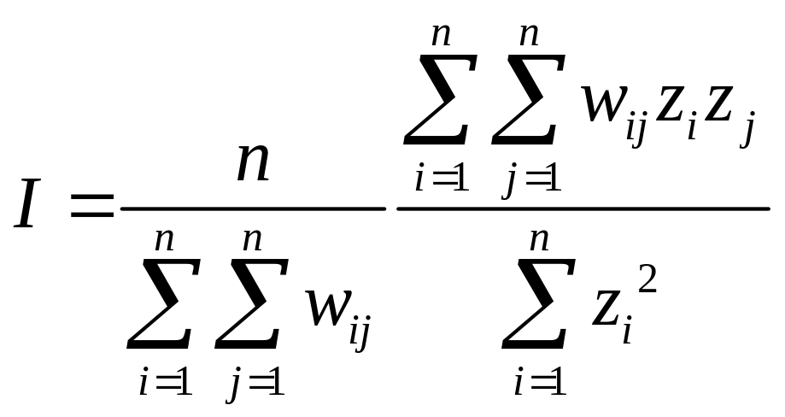
Spatial Correlation
Moran’s I
*Row standardization?

Slide 13
Spatial Correlation
A₂
A₁
A₃
A₆
A₄
A₅

Slide 14
Proximity Matrix
A₁
A₂
A₃
A₄
A₅
A₆
0 | 1 | 0 | 0 | 0 | 1
1 | 0 | 1 | 0 | 0 | 0
0 | 1 | 0 | 1 | 0 | 0
0 | 0 | 1 | 0 | 1 | 0
0 | 0 | 0 | 1 | 0 | 1
1 | 0 | 0 | 0 | 1 | 0
A₁
A₂
A₃
A₄
A₅
A₆

Slide 15
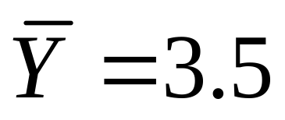
Spatial Correlation
4
5
A₂
3
A₁
A₃
A₆
A₄
4
A₅
2
3
I=0.9091
Z(I)=1.4097

Slide 16
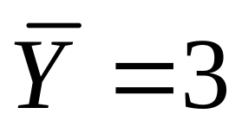
Spatial Correlation
1
5
A₂
5
A₁
A₃
A₆
A₄
1
A₅
1
5
I=-2.000
Z(I)=-3.7417

Slide 17
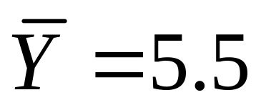
Spatial Correlation
7
10
A₂
4
A₁
A₃
A₆
A₄
7
A₅
1
4
I=0.9091
Z(I)=1.4097

Slide 18
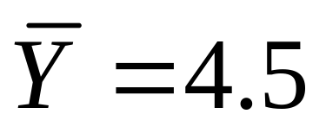
Spatial Correlation
4
5
A₂
5
A₁
A₃
A₆
A₄
4
A₅
4
5
I=-2.000
Z(I)=-3.7417

Slide 19
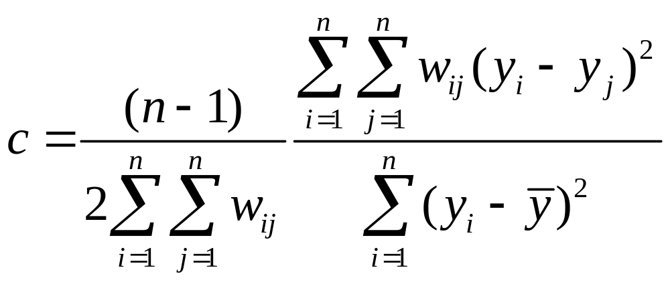
Spatial Correlation
Geary’s c

Slide 20
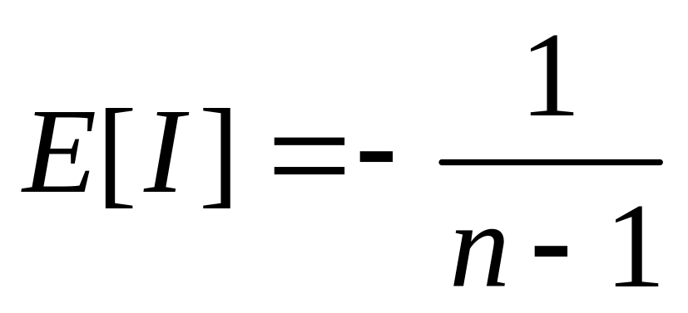
Moran’s I
Expected value (mean)
  Under the assumption of no autocorrelation!
* Testing for significance

Slide 21
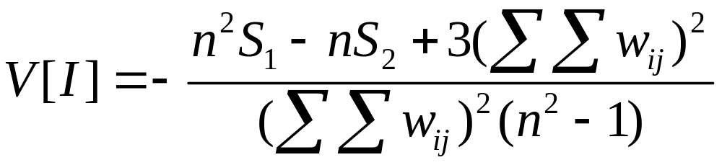
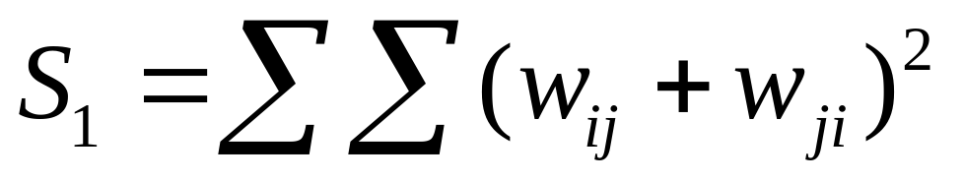
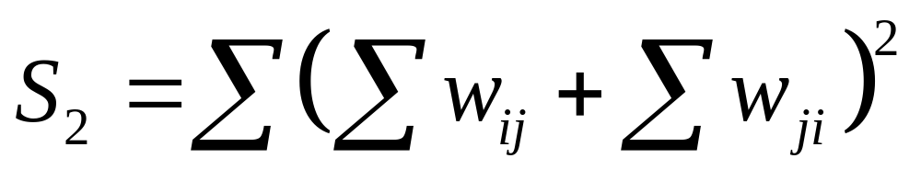
Moran’s I
Variance

Slide 22
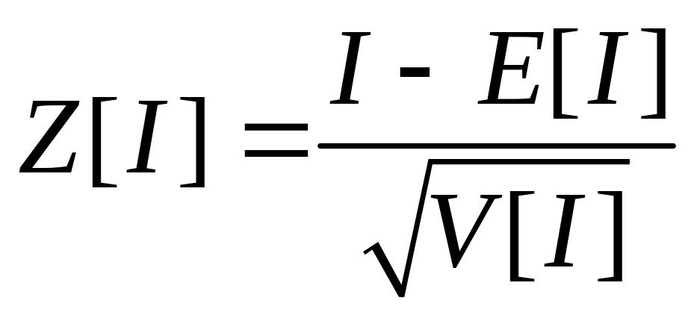
Moran’s I
Testing for significance
  Asymptotically normally distributed
* Testing for significance

Slide 23
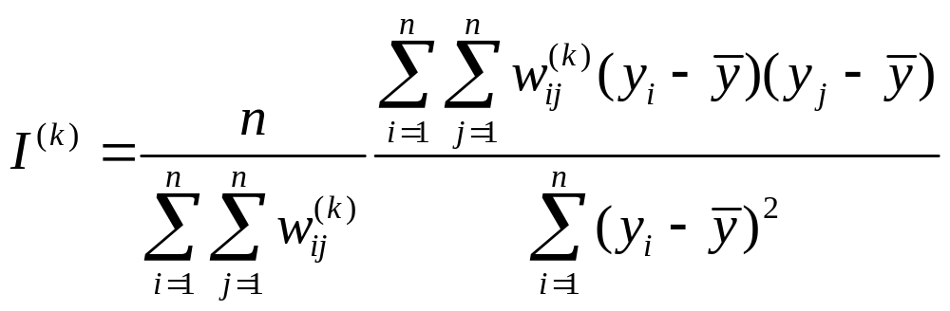
Higher Order Neighbors
Moran’s I using higher order neighbors

Slide 24
Correlogram
A graph showing the value of Moran’s I at different distances

Slide 25
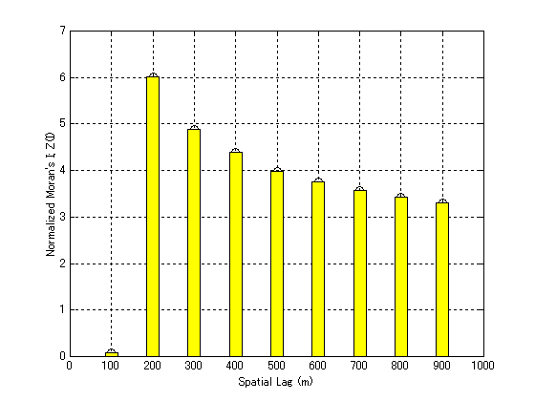
Correlogram:
Land Prices in a Japanese City

Slide 26
Example: Spatial-Temporal Spread of AIDS in Florida (1982-1990)
8
8
8
6
1982
6
1983
6
1984
4
4
4
2
2
2
0
0
0
-2
-2
-2
-4
-4
-4
-6
1 2 3 4 5 6 7 8
-6
1 2 3 4 5 6 7 8
-6
1 2 3 4 5 6 7 8
8
8
8
6
1985
6
1986
6
1987
4
4
4
2
2
2
0
0
0
Source: N. Lam, M. Fan and K. Liu (1996)
-2
-2
-2
-4
-4
-4
-6
1 2 3 4 5 6 7 8
-6
1 2 3 4 5 6 7 8
-6
1 2 3 4 5 6 7 8
8
8
8
6
1988
6
1989
6
1990
4
4
4
2
2
2
0
0
0
-2
-2
-2
-4
-4
-4
-6
1 2 3 4 5 6 7 8
-6
1 2 3 4 5 6 7 8
-6
1 2 3 4 5 6 7 8

Slide 27
Global Statistics
Global patterns
1 statistic for all the study area
What is happening at specific locations?

Slide 28
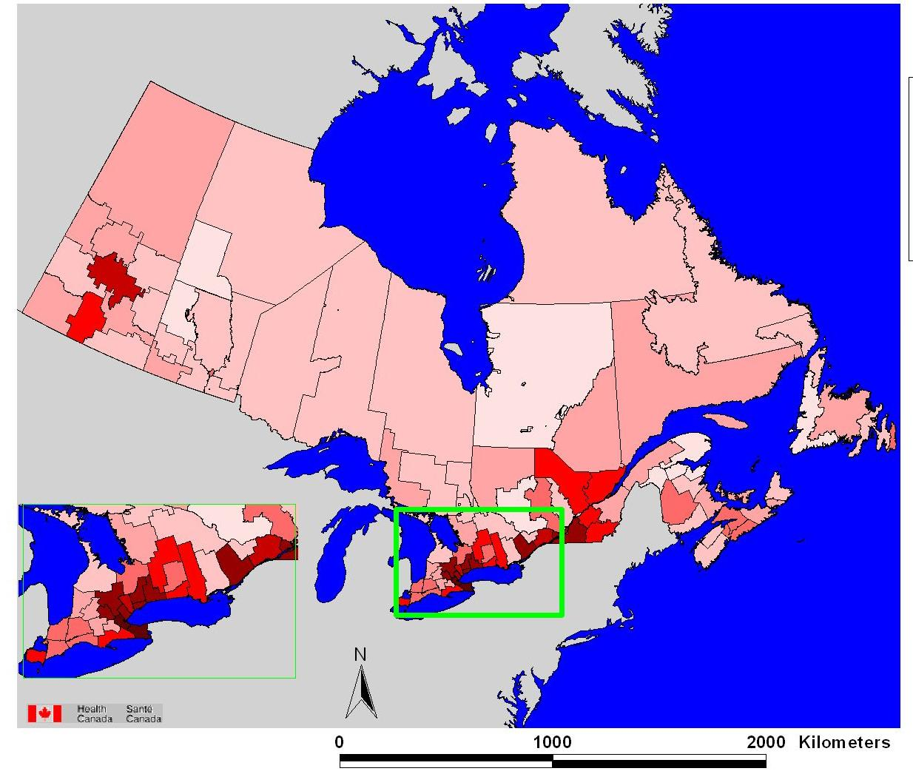
Global Statistics

Slide 29
Local Statistics
Local Indicators of Spatial Association (LISA)
Getis and Ord G_{i}(d) statistic

Slide 30
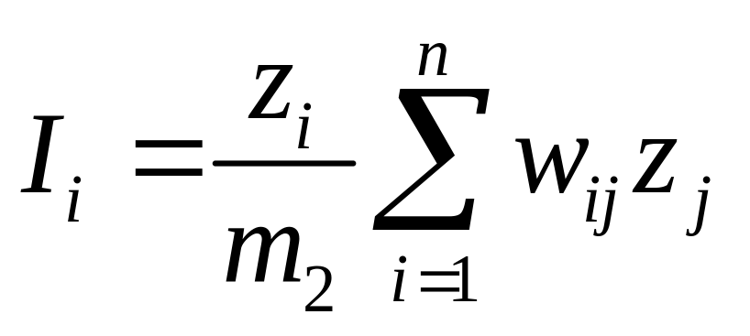
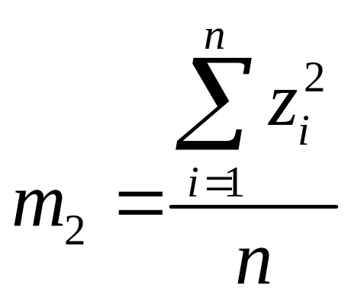
LISA
Decomposition of Moran’s I
*Patterns of association

Slide 31
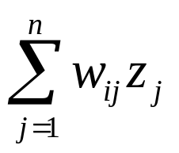

Moran’s Scatterplot
L-H
H-H
L-L
H-L

Slide 32
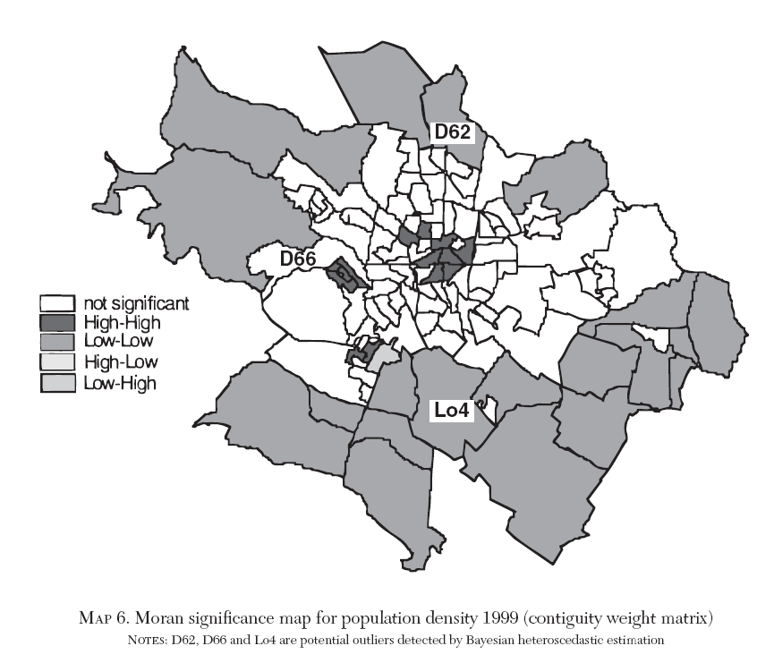
Moran’s Map:
Population Density Dijon (France)
Source: C. Baumont, C. Ertur, J. LeGallo (2003)

Slide 33
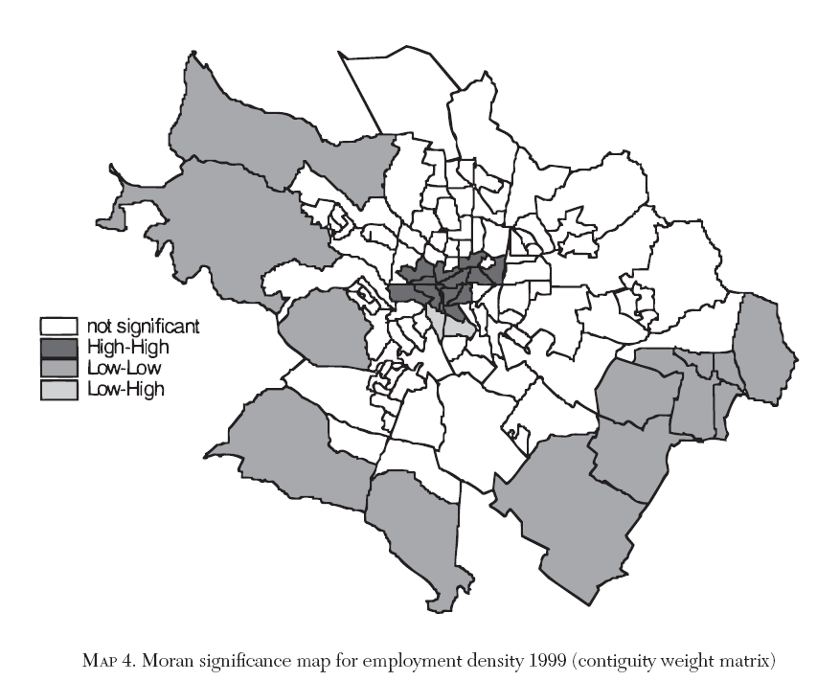
Moran’s Map:
Population Density Dijon (France)
Source: C. Baumont, C. Ertur, J. LeGallo (2003)

Slide 34
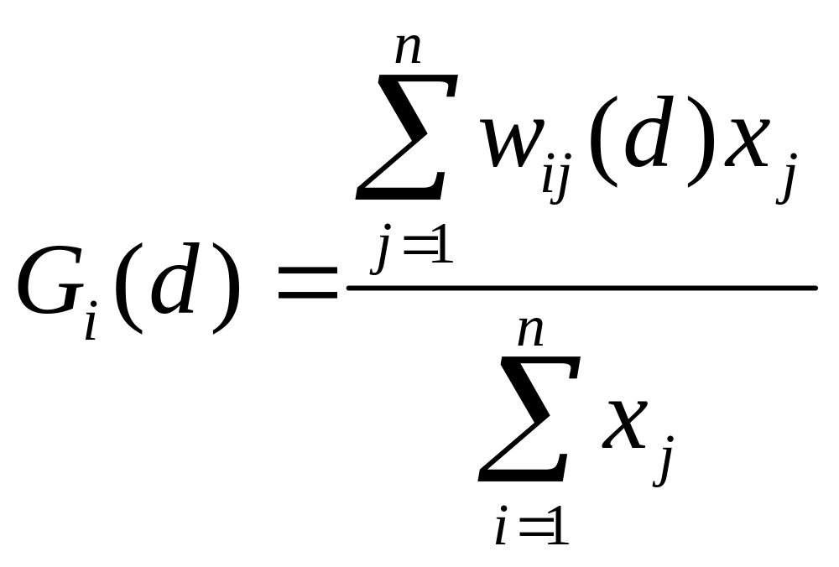
Getis and Ord G_{i}(d) statistic
Indication of the concentration or lack of concentration of a variable

Slide 35
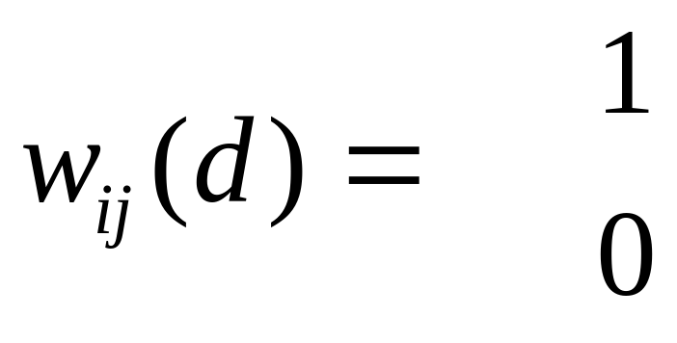
Getis and Ord G_{i}(d) statistic
Binary proximity matrix
if d_{ij} < d
otherwise

Slide 36
Getis and Ord G_{i}(d) statistic

Slide 37
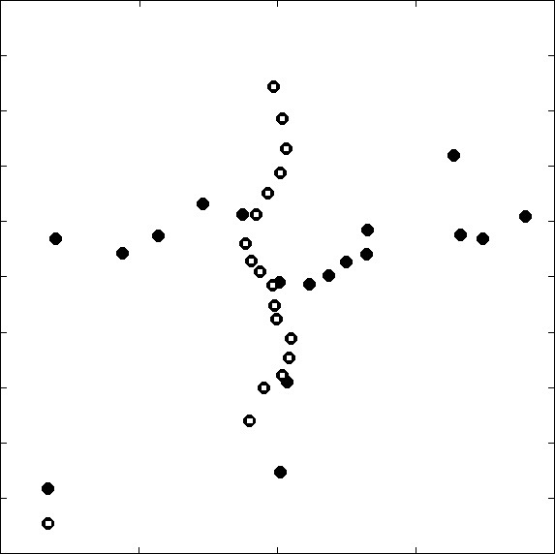
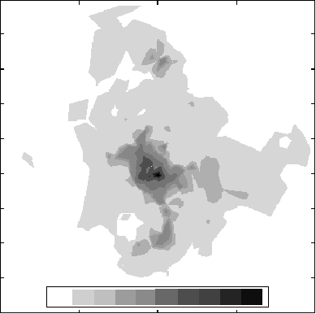
Getis and Ord G_{i}(d) statistic
Subway and Train Stations
20
18
16
14
12
10
8
6
4
2
Izumi
Iwakiri
Kita Sendai
Northing (km)
Ochiai
Northing (km)
Sendai
Nagamachi
Train Station
Minami Sendai
0 100 200 300 400 500 1000 2000 3000 4000 5000
Subway Station
0 5 10 15 20
0 5 10 15 20
Easting (km)
Easting (km)
Fig. 1 a) Subway and train stations in Sendai City; b) Land price profiles (unit: \10 000/m²)

Slide 38
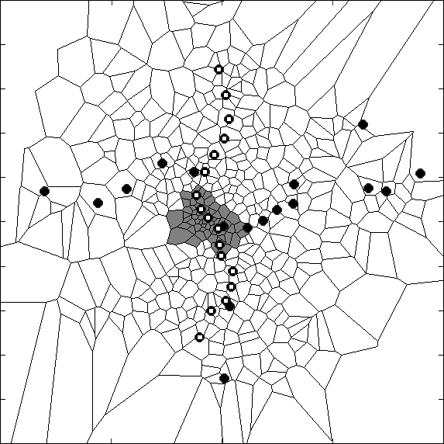
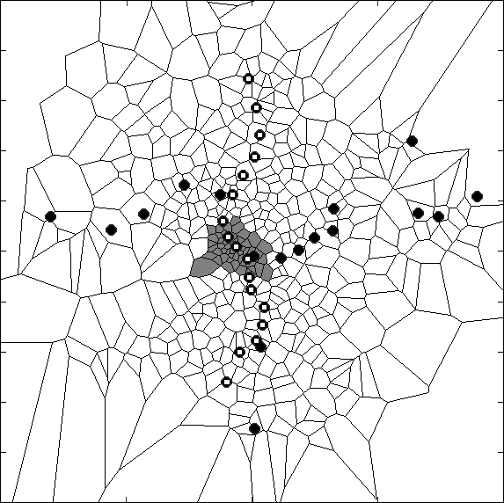
Getis and Ord G_{i}(d) statistic
Case 1) Significance Test
α = 0.05
(Without Correction)
Case 2) Significance Test
α = 0.0001
(With Correction)
Izumi Station
Izumi Station
Sendai Station
Sendai Station
Nagamachi Station
Nagamachi Station
Scale 5km
Scale 5km
Z(G
i
) Significant Observation (+)
Z(G
i
) Non-significant Observation
Fig. 2 Local autocorrelation analysis: a) Without Bonferroni correction; b) With Bonferroni correction

Slide 39
Example
Exploratory Data Analysis
Visualization and exploration of area data
  First order properties
  Second order properties

Slide 40
Example
Presidential election voter turnout (Kansas, 1980)

Slide 41
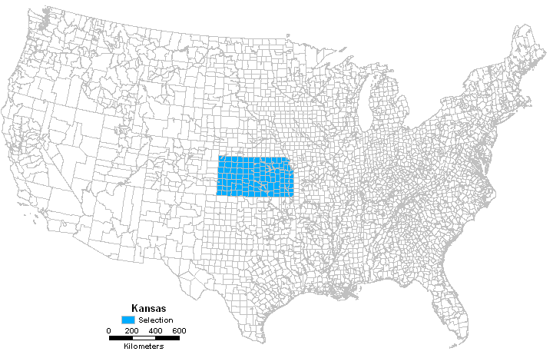
Example
Kansas

Slide 42
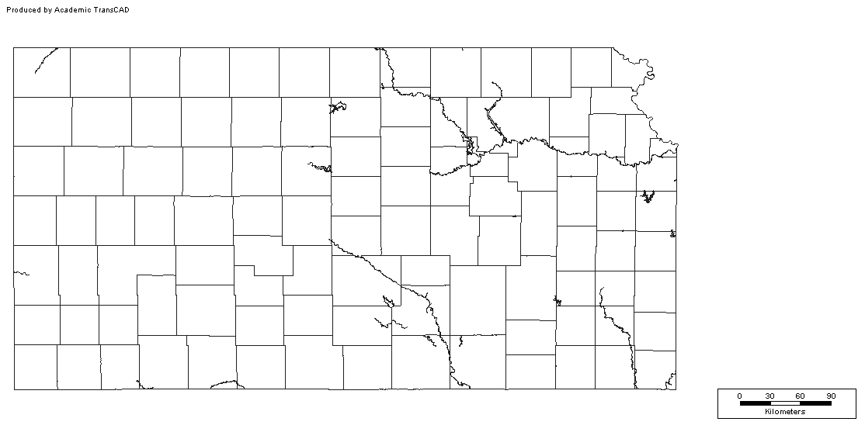
Definitions: Irregular Lattice
Counties in Kansas State

Slide 43
Example
Presidential election voter turnout (Kansas, 1980)
  Total number of votes cast per county in the 1980 presidential election for both candidates (VOTES)
  Voting age population (POP)
  Population in each county with 12th grade or higher education (EDU)
  Number of owner occupied houses (HOUSE)
  Aggregate income in the county (INCOME)

Slide 44
Example
Presidential election voter turnout (Kansas, 1980)
  Potential issues
    What are the factors that influence voter turnout?
    How can voter turnout be increased?
    Certain population segments are more commonly identified with a given political party

Slide 45
Example: Voter turnout
Zoning system: 105 counties

Slide 46
Example: Voter turnout
Zoning system: 105 counties
  Proximity matrix defined in terms of first order contiguities

Slide 47
Exploratory Data Analysis
Univariate analysis
  Histogram
  Maps
  Moving averages
  Autocorrelation

Slide 48
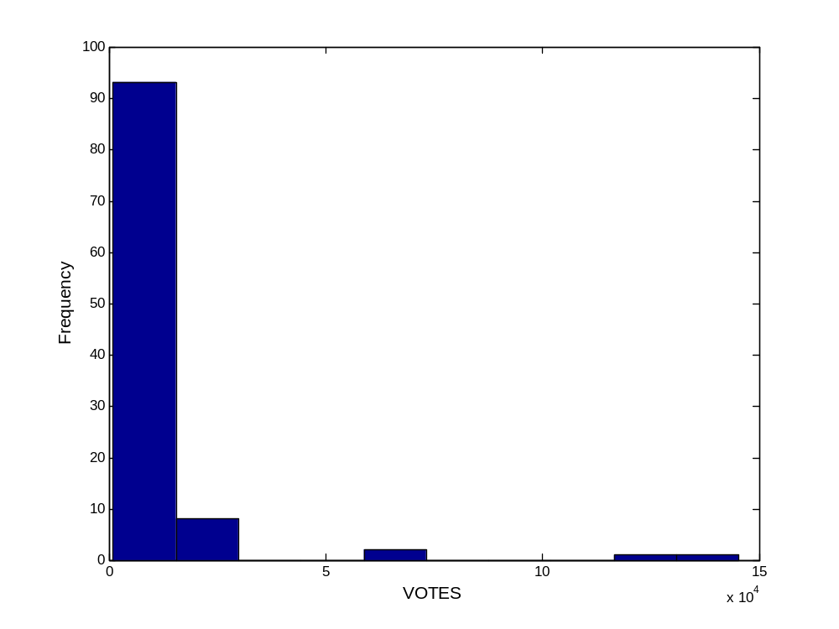
Exploratory Data Analysis
Histogram: Votes

Slide 49
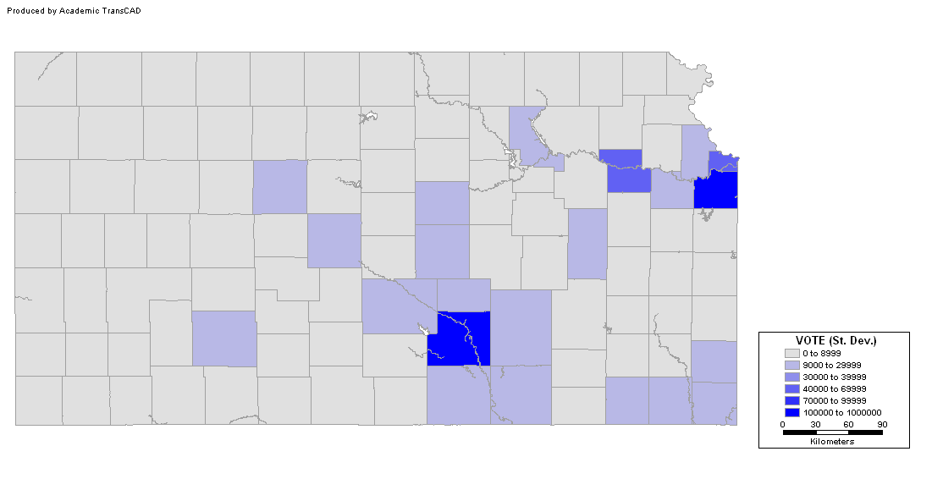
Exploratory Data Analysis
Choropleth map: Votes (Std. Dev.)
Notes:
What is the advantage of using standard deviations?

Slide 50
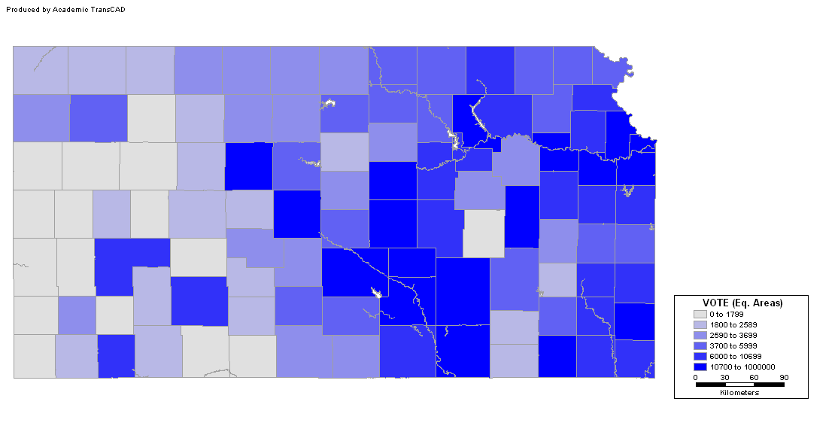
Exploratory Data Analysis
Choropleth map: Votes (Eq. Areas)

Slide 51
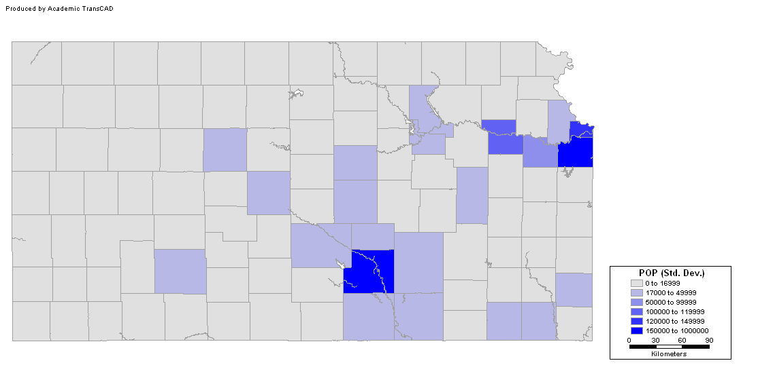
Exploratory Data Analysis
POP (Std. Dev.)
Notes:
What is the advantage of using standard deviations?

Slide 52
Exploratory Data Analysis
Votes
Notes:
What is the advantage of using standard deviations?

Slide 53
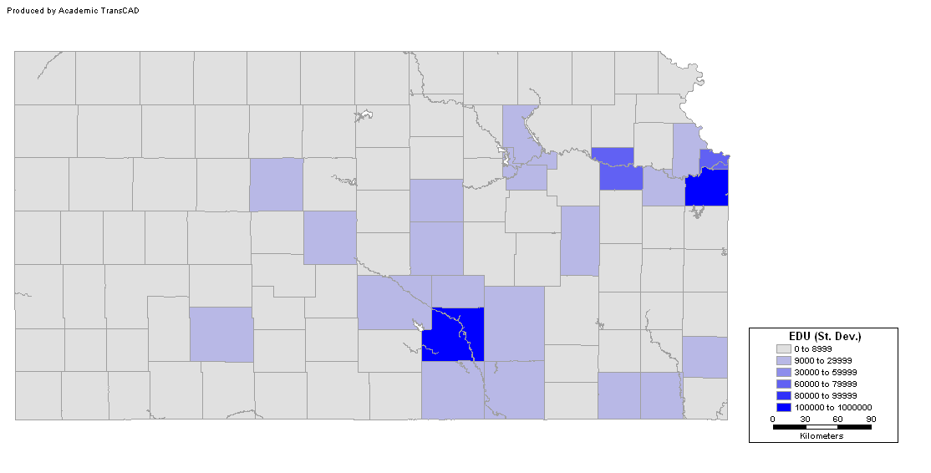
Exploratory Data Analysis
EDU (Std. Dev.)
Notes:
What is the advantage of using standard deviations?

Slide 54
Exploratory SPATIAL Data Analysis
Spatially moving averages (first order properties)
Spatial autocorrelation (second order properties)

Slide 55
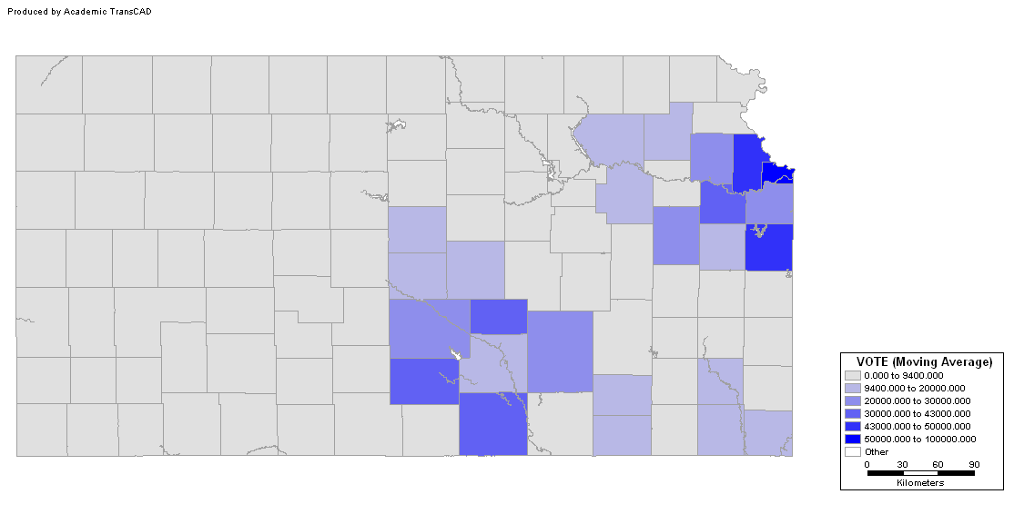
Exploratory Spatial Data Analysis
Votes (Moving Average)

Slide 56
Exploratory Spatial Data Analysis
Spatial autocorrelation
  Standardized Moran’s I (normal distribution)
  Null hypothesis: no autocorrelation
  All tests are significant (p<0.05)
Variable | Z(I)
VOTE | 3.47
POP | 3.78
EDU | 3.36
HOUSE | 3.75
INCOME | 3.14

Slide 57
Conclusion
Voting patterns follow a spatial pattern
The spatial pattern is very clear, and probably relates to urban concentrations
Voting is probably correlated with population, education and other variables

Slide 58
Next…
Area data V & VI
  Non-spatial regression
  Error autocorrelation and other guidelines for model evaluation
  Spatial regression

